Slide 1
Week 7
Machine Learning
libSVM

Slide 2
Overview
We’re going to take a dip into the ocean of ML
This will serve only as a very brief introduction
Basic concepts, a specific approach, and one implementation
Once you get used to ML, it stays with you
It’s not a magic bullet, but it’s close
We’ll talk about how to set up the problem, solve it, and some common pitfalls encountered
Finally, we’ll wrap up with why phones don’t usually do live ML

Slide 3
Machine Learning
Computer Programming + Knowledge:
“If you really want to know something, teach it to a computer”
ML is what we turn to when we have no knowledge
In short, we teach computers things we don’t know
Naturally, this makes for some hilariously nonfunctional situations
Amazingly, ML works a lot of the time
Enough that you will start throwing it at problems before really thinking
Sometimes, that will be good enough
Often, it isn’t!
Unsurprisingly, ML works best alongside Knowledge
We’ll see this in the demo at the end of class

Slide 4
Machine Learning
We phrase our problems as Classification problems
We are trying to classify pieces of data as one class, or another
This is in contrast to clustering algorithms, state modeling, etc…
There are variations on even this subtopic
Multiple classes
Supervised vs. Unsupervised, etc….
We will start the simplest, most direct approach
Supervised learning, with the aim of classification into two classes
Identical to a “detection” problem

Slide 5
Machine Learning
Our ML algorithms all use the same basic approach
Construct feature vectors out of our data
Label each feature vector as either class 0 or class 1
Perform some magic to construct a model off of this training data
Use that model to classify unlabeled feature vectors
From our perspective, most of the work is in step #1
Feature design can make or break your classifier
Nonseparable features cannot be classified
Model construction, classification, etc. are magic
By that, I mean we won’t talk about it much, we’ll just assume it works

Slide 6
Feature Vectors
Feature Vectors are representations of our data
Assume our data is about grip strength of humans
Data points: Age, Gender, Left and Right hand grip strength
We can take this data, and represent it as a Vector
Four dimensions, those data points mentioned above
Visualizing the spread of N-dimensional data is hard
So we tend to only look at two or three dimensions at a time

Slide 7
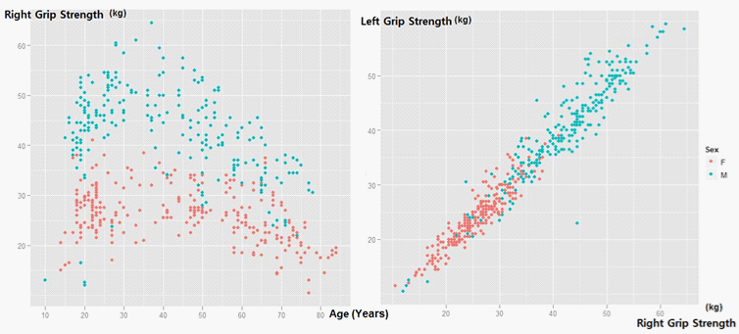
Feature Vectors
Features map data to N-dimensional vectors
We can mash all sorts of quantifiable data together in a vector

Slide 8
Feature Vectors
Separability is key
Essentially, “can you draw a line between the two classes”

Slide 9
Model Construction
Models separate our classes in the feature space
If it’s a linear classifier, this means drawing hyperplanes
There are many, many ways of doing this
We’re going to start with KNN, one of the simplest
K Nearest Neighbors
Looks at the K nearest training points
Nearest defined with respect to some norm, usually Euclidean
Other norms useful too, the L0 (“taxicab”) norm can be interesting
Of those K training points, choose the majority class as the answer

Slide 10
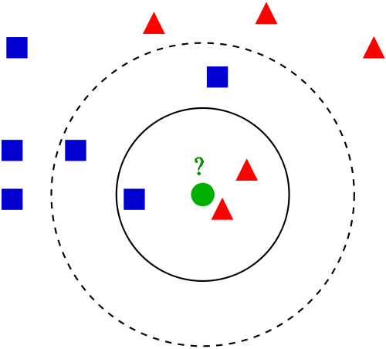
K Nearest Neighbors

Slide 11
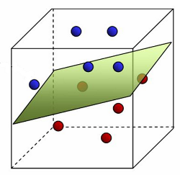
Linear Classifiers

Slide 12
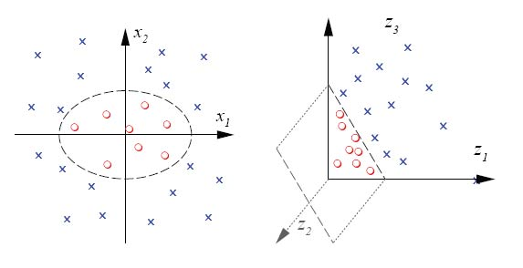
Non-Linearly Separable
Some data sets are not linearly separable
Attempting to use linear classifiers will achieve very low accuracy

Slide 13
Support Vector Machines
Allow us to classify nonlinear regions efficiently
Although we can use nonlinear separation functions, they are slow
SVMs get around this by using the “kernel trick”
Projects data onto a higher dimensional surface
A hyperplane in this higher dimensional space projects down to a nonlinear separating function in the lower dimensional space

Slide 14
libSVM
Provides a programming interface for SVM tasks
Classes such as svm_model, svm_parameter, svm_problem, svm_node, etc…
Usage recipe is:
Load training data into svm_node structures
Load svm_node structures into svm_problem
Use cross-validation to search for good values for svm_parameter struct
Use good found svm_parameter and svm_problem to generate svm_model
Use svm_model to classify further svm_node structures
There are bindings in quite a few languages
We will be using C#

Slide 15
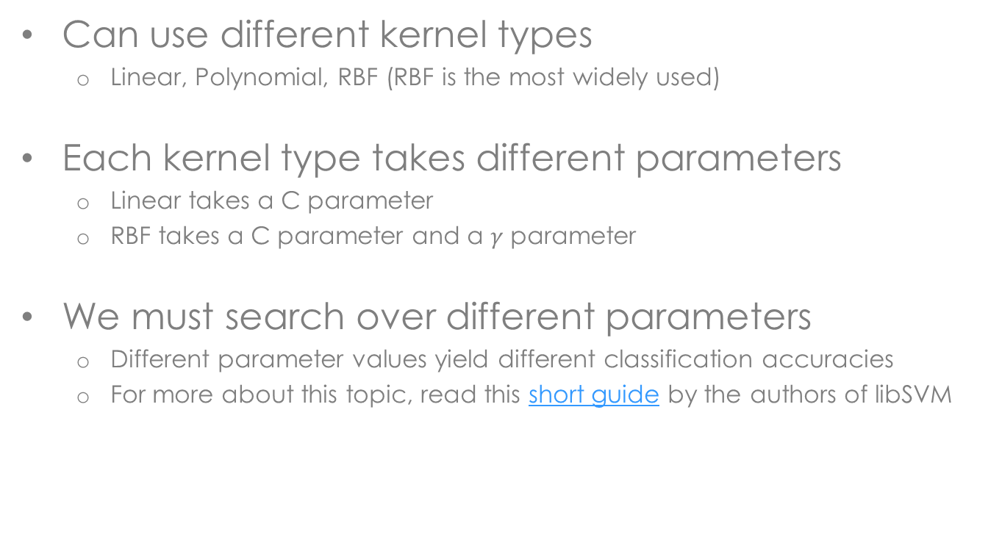
libSVM
Can use different kernel types
Linear, Polynomial, RBF (RBF is the most widely used)
Each kernel type takes different parameters
Linear takes a C parameter
RBF takes a C parameter and a $γ$ parameter
We must search over different parameters
Different parameter values yield different classification accuracies
For more about this topic, read this short guide by the authors of libSVM

Slide 16
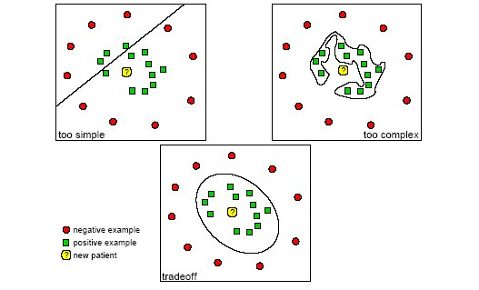
Overfitting
Caveats exist, as with all solutions devised by man
Overfitting is what happens when your model is too complex

Slide 17
Cross-validation
Overfitting typically is the fault of some parameters
Yields very high test scores for all testing data
Does not generalize well to data that is not exactly equal to testing data
To combat this, we use cross-validation
Segments training data into a Training and Testing
Builds a model using the given parameters and the Training section
Tests the model on the Testing section, reports back the classifications
Repeat for many different segmentations of Training and Testing
Cross-validation is computationally expensive
It is also totally worth it, and should be used whenever possible

Slide 18
More Risky Live Demos

Slide 19
Looking Forward
Final projects are now your main focus
Presentations will happen over the last two weeks of class
Looking for volunteers to present on June 2nd, instead of June 9th
Remember that a final project report is due as well
Don’t spend all your time coding….. just most of it
Reports will be submitted electronically, I will open a dropbox
Monday, May 26th is a day off for us all
I won’t be here that day, so please don’t show up either!

